Slide 1
Sanitary Engineering
Water supply Engineering
By
Dr. Muhanad M. Abbas

Slide 2
TODAY TOPICS
Treatment Of Water Supply
Rapid Mix (Coagulation) Unit.
Flocculation.

Slide 4
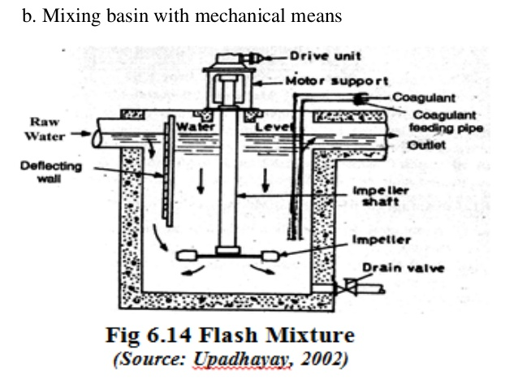

Slide 5
Flocculation

Slide 6
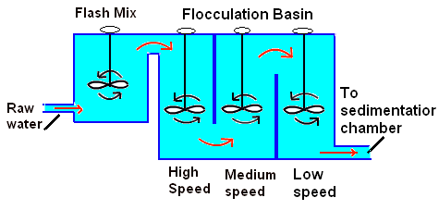

Slide 7
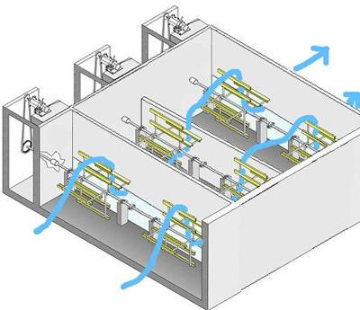

Slide 8
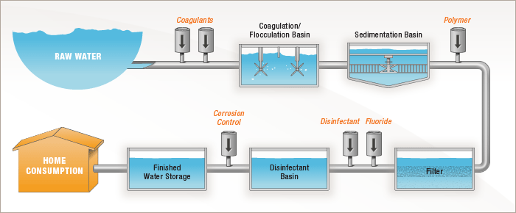

Slide 9
